Slide 1

Car Accidents Prevention
CS226 Big Data Management Fall 2023
GROUP NAME: THE FATE CHANGER
GROUP NUMBER: 07
TEAM MEMBERS:
Tushar Baid
Aswini Shilpha S S
Vishal Rohith Chinnam
Sree Keerthi Reddy Gudipati
Cameron Tsai

Slide 2
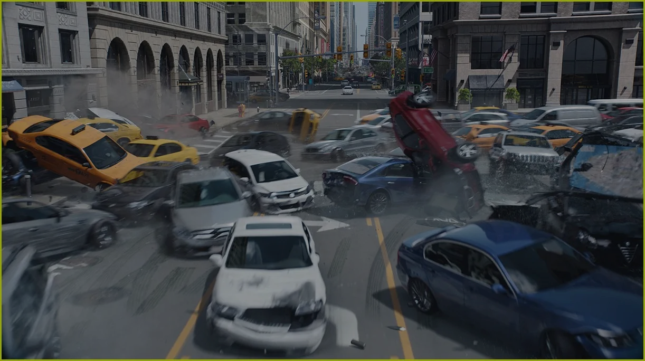
BACKGROUND
Road safety is one of the topmost concerns
According to WHO, approximately 1.3 million lives are lost annually in road traffic accidents.
The Centers for Disease Control and Prevention (CDC) estimates that crash injuries are the eighth leading cause of death globally for all age groups and the leading cause of death for children and people from ages 5-29.
Despite modern vehicle technologies, fatalities remain high.
Ongoing research and development to make roads safer.

Slide 3
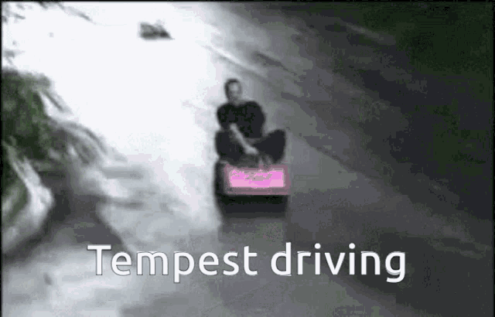
MOTIVATION
Road traffic accidents result from multiple causes, including speeding, drunk driving, and phone usage.
However, a significant number of accidents occur due to factors beyond driver's control.
Conditions like road type, weather, and time of day can significantly influence accident rates.
Identifying relationships between these conditions and accidents enables proactive measures.
Taking action based on these insights can effectively reduce accident occurrences.

Slide 4
RELEVANCE TO BIG DATA
Since our data is static, it does not satisfy the velocity component.
The dataset contains some outliers and noisy data, which we handled in the data cleaning process.
VELOCITY
4 V’s of Big Data
VERACITY
VOLUME
Size of the dataset: 3.1 GB,
7,728,394 Rows
VARIETY
The data has been collected from a variety of entities that help us manipulate and analyze the data.

Slide 5

OUR WORK
OVERVIEW OF THE DATASET AND USE CASE
We got our dataset from Kaggle.
The size of dataset is 3.1GB.
It includes 49 states of the USA.
The accident data were collected from February 2016 to March 2023. The dataset currently contains approximately 7.7 million accident records.

Slide 6

OUR WORK
CLEANING AND PREPROCESSING DATA
The dataset initially had 46 features and 7,728,394 rows.
Duplicate rows were removed, and those with over 40 null values were dropped.
Missing values were filled using forward and backward methods.
To reduce dimensionality, 16 columns were removed, and rows with null values in three specific columns were dropped.
Post-cleaning, 31 features and 5,989,916 rows remained.
The cleaned dataset was saved as a Parquet file.

Slide 7
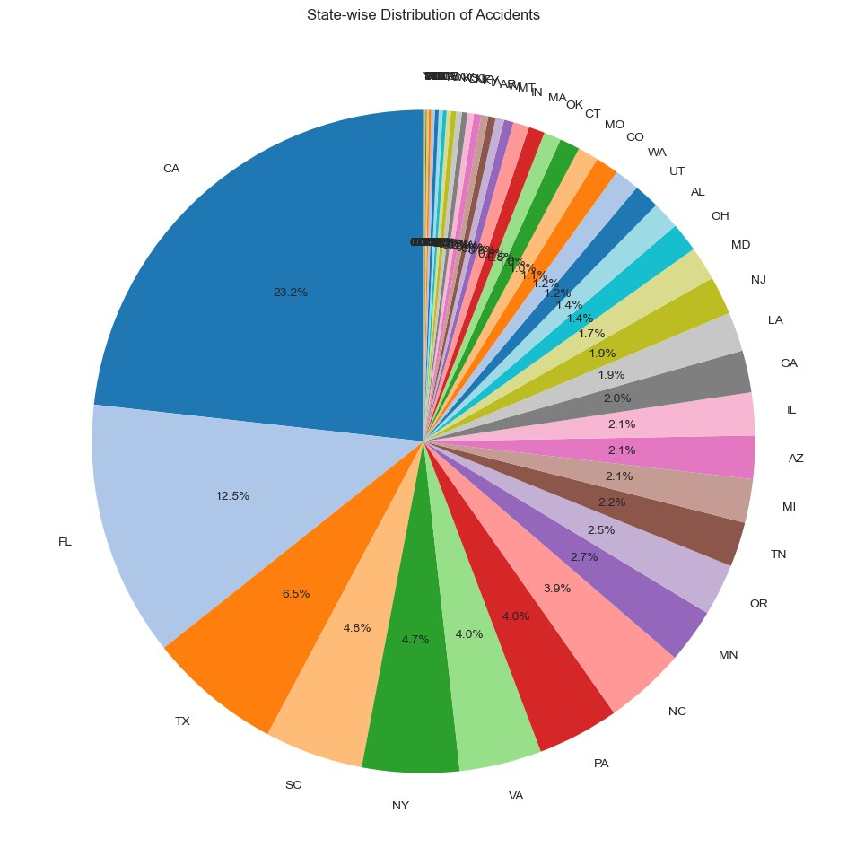
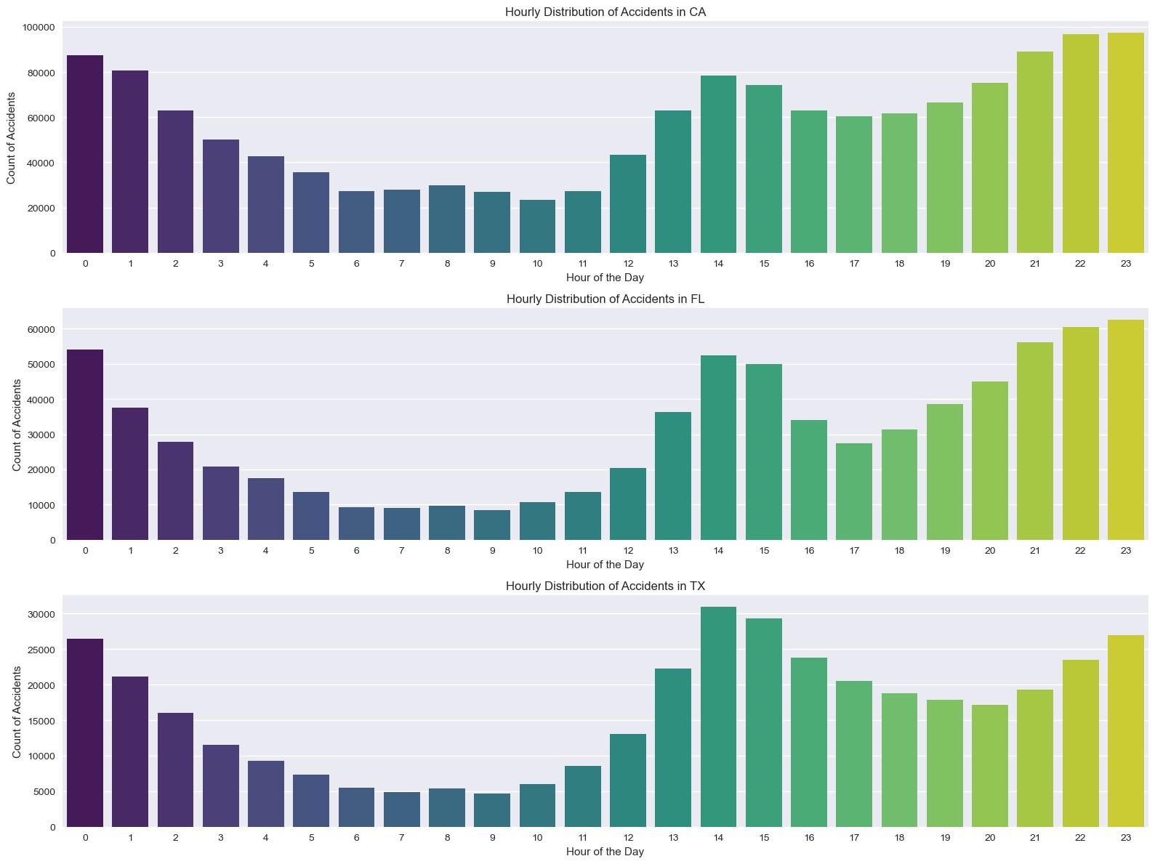

OUR WORK
DATA ANALYSIS AND VISUALIZATION
State-wise Aggregation

Slide 8
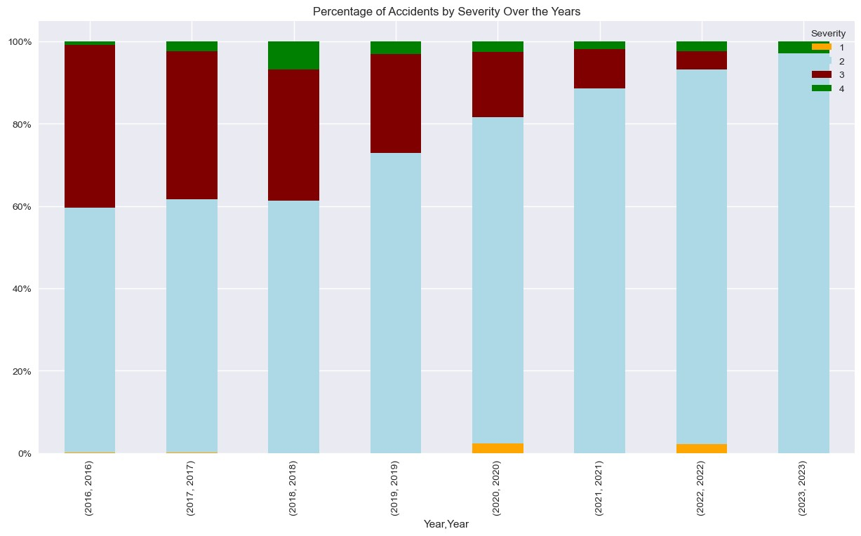
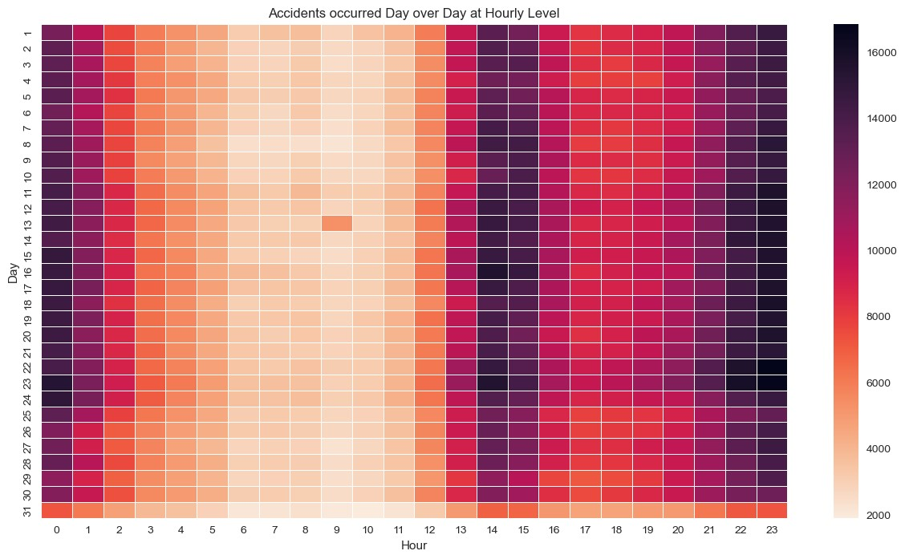
OUR WORK
DATA ANALYSIS AND VISUALIZATION CONTD.
Temporal Trends
Notes:
Hi All,
This is Aswini Shilpha S S here.
I’ll be talking about how our project is relevant to Big Data starting with the 4 Vs that is Velocity, Volume, Variety and Veracity.
The dataset we have considered for our project is about 3.1 GB which is a huge volume of data to process and analyz. And it contains data from various entities including the US and State Departments of Transportation, Law Enforcement Agencies, Traffic cameras and sensors and this datasets contains some outliers and noisy data which would be handled during preprocessing which involves Veracity.
Next we’ll talk about the dataset. We have obtained the dataset from Kaggle. The size is about 3.1 GB and it has US Accidents Data from 2016 to 2023 with 7.7 million records.
Next we’ll talk about Cleaning and Preprocessing of Data before we start analyzing it.
Here, we’ll start by removing duplicates, dropping null valued columns and to reduce dimensionality, 16 columns were dropped, Missing values were filled using forward and backward method. Post Cleaning and preprocessing, we had 31 Features and 5.9 Million Records. This cleaned dataset is saved as Parquet File for easy access to read and analyze.
Next we’ll talk about, Data Analysis and Visualization based on Parquet File.
Here, multiple visualizations are implemented to analyze and get more insights using these attributes.
As per the Pie Chart, we can identify the top states with more % of Accidents and from the bar graph we can identify when do these accidents occur at hourly level i.e for CA and FL, it’s mostly during the night and for TX its during the rush hour from 1-3pm.
Next, we have implemented Temporal Trends Visualizations.
Here, using Graphs and Heatmaps, we can identify which year had most severe accidents and on a hourly level, we can identify that most accidents have occurred in the night or during the rush hours from 1-3pm.

Slide 9
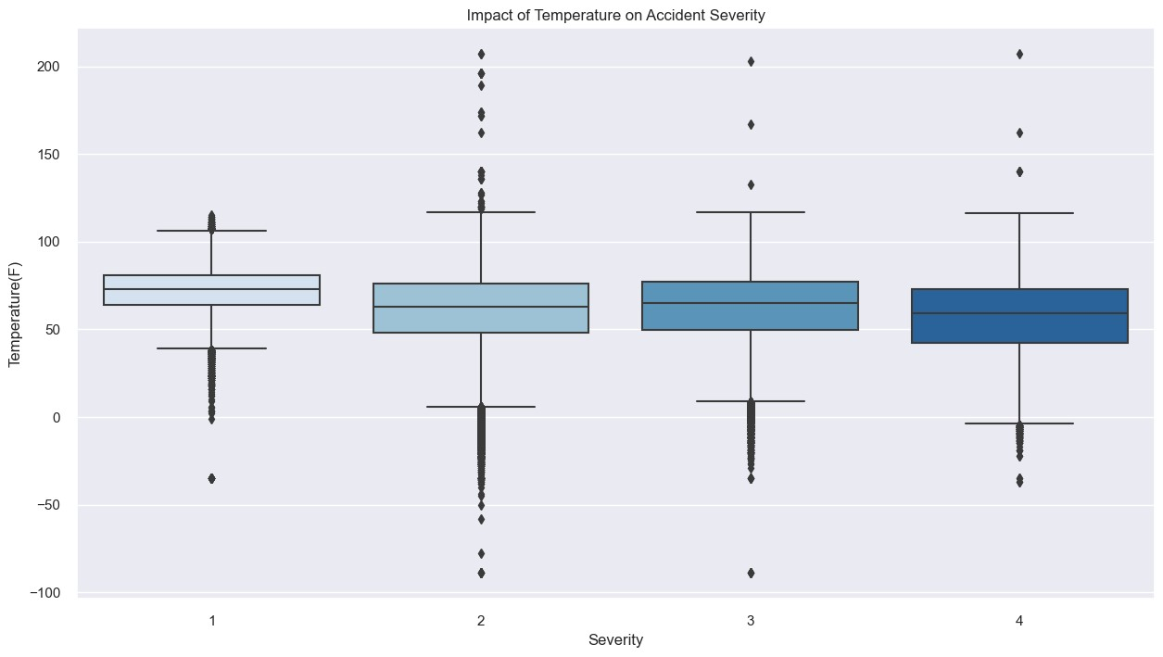
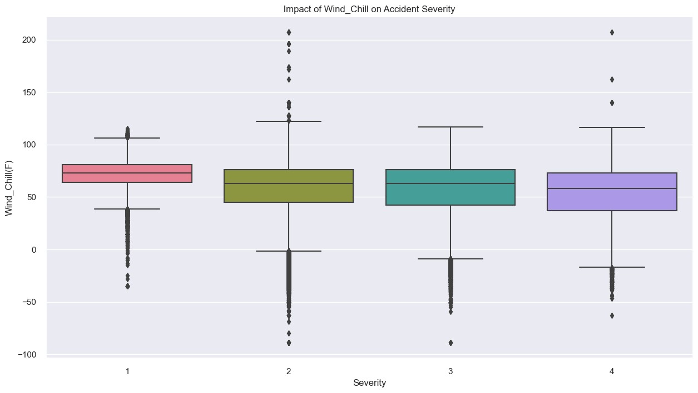
OUR WORK
DATA ANALYSIS AND VISUALIZATION CONTD.
Weather Impact

Slide 10
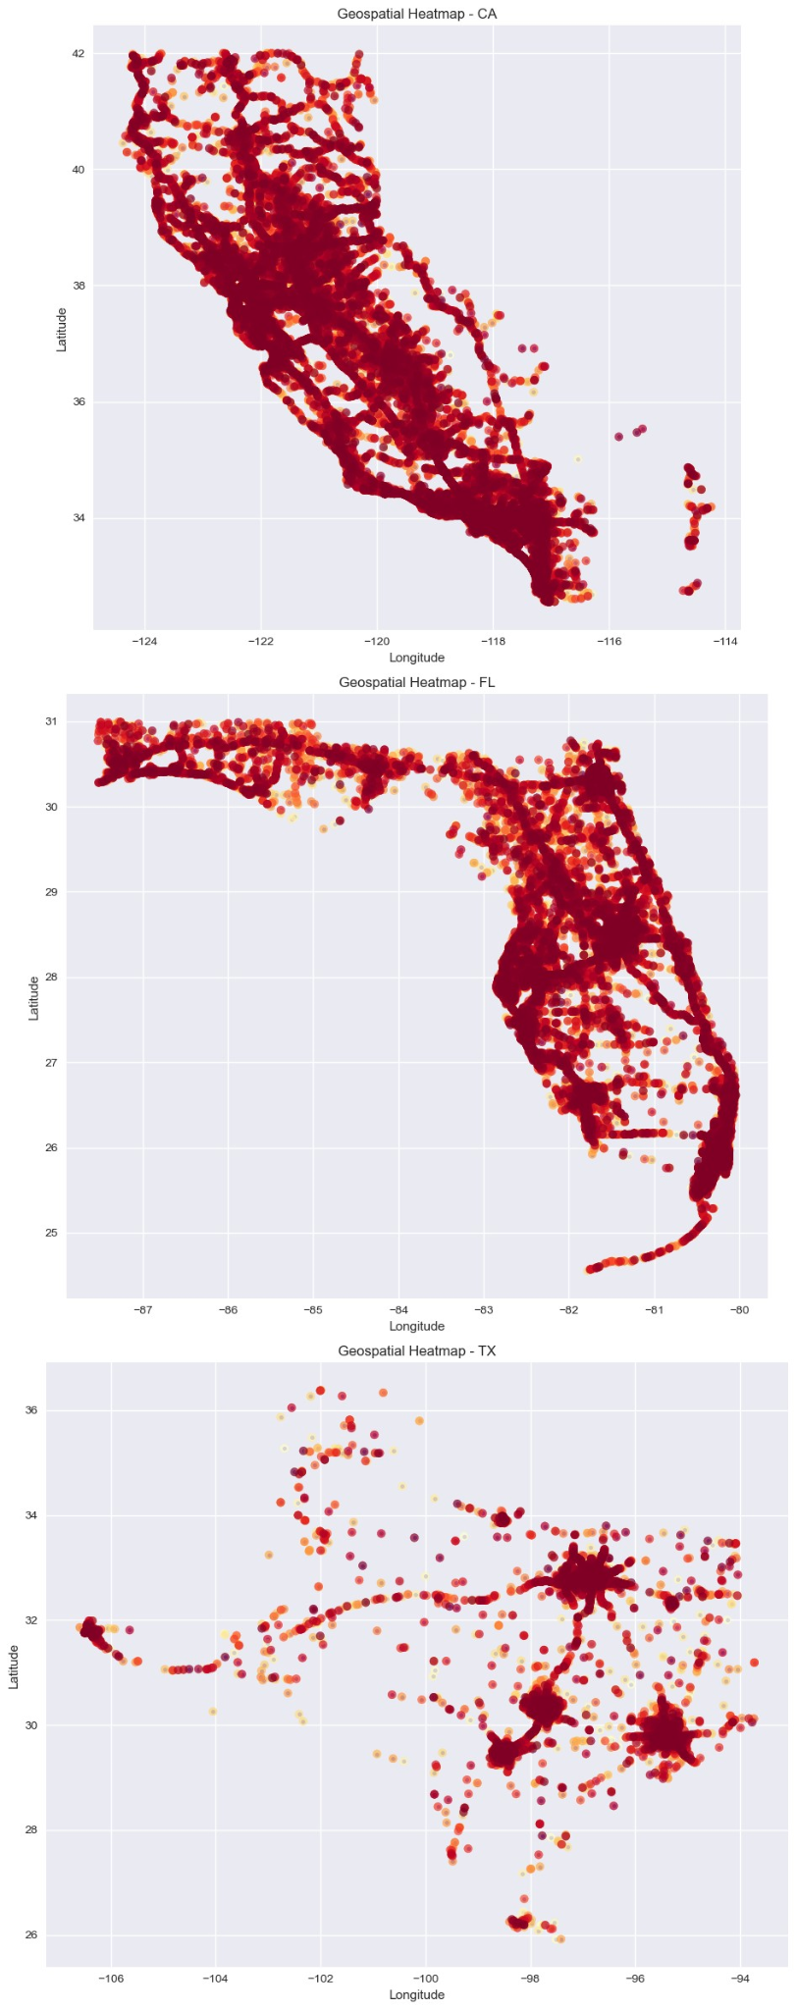
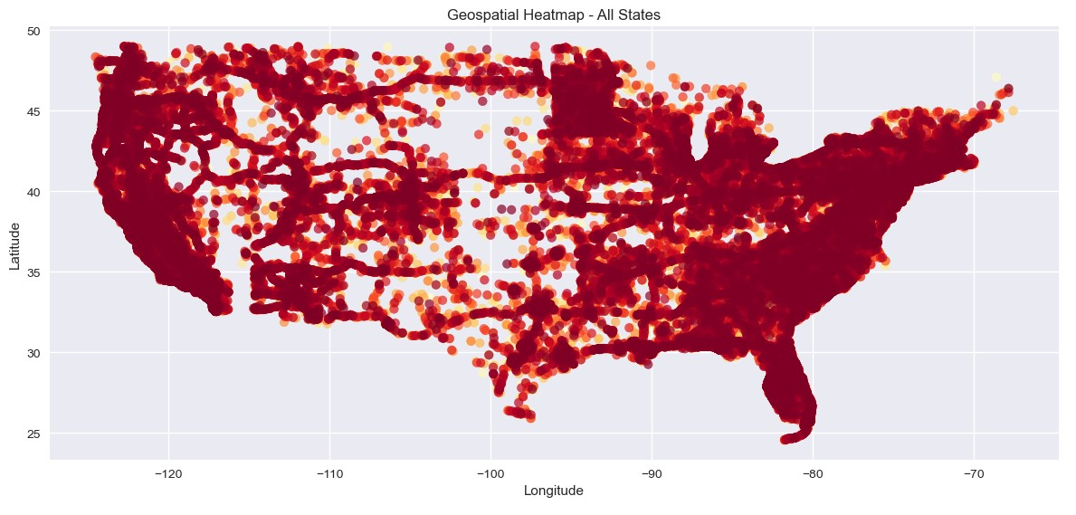
OUR WORK
DATA ANALYSIS AND VISUALIZATION CONTD.
Geospatial Heatmaps

Slide 11

OUR WORK
CHOOSING THE MODEL
ML Algorithms
Classification
Regression
Random Forest
Gradient Boosting
PCA & Linear Regression

Slide 12







OUR WORK
TOOLS & TECHNOLOGIES

Slide 13

OUR WORK
EVALUATING THE MODEL
Random Forest Classification Metrics
Accuracy
Precision
Recall
F1 Score
Regression models (GBT and Linear Regression ) Metrics
RMSE (Root Mean Squared Error)
MAE (Mean Absolute Error)

Slide 14

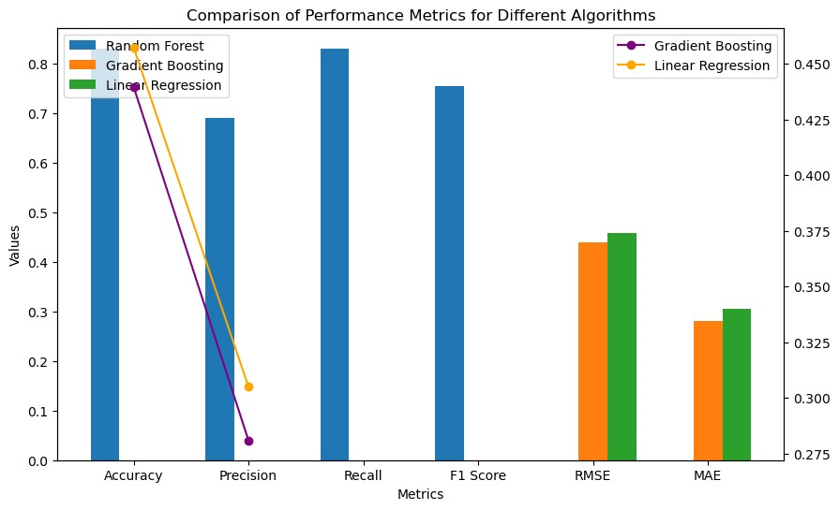
RESULTS & PERFORMANCE
Accuracy, Precision, Recall, F1 Score, RMSE, MAE
Classification and Regression
Random Forest achieved an accuracy of 83%

Slide 15
RELATED WORK
Traffic Safety Studies: Past research has explored various factors influencing accidents, including driver behavior, infrastructure, and environmental conditions.
Big Data Applications: Utilizing large datasets and machine learning techniques has enabled predictive modeling to identify accident patterns and anticipate potential risks.
Geospatial Analysis: Geographic Information Systems (GIS) have mapped accident hotspots, aiding in targeted interventions and safety measures.
Weather Impact Studies: Research has highlighted the correlation between adverse weather and increased accident rates, emphasizing the need to integrate weather data in safety strategies.

Slide 16

FUTURE WORK
US Accidents dataset analysis revealed crucial insights into the factors affecting road accidents, particularly weather conditions, atmospheric variables, and geographical locations.
Actionable recommendations are provided for policymakers, transportation authorities, and stakeholders to improve road safety.
A system for recommending alternative routes and an alert system that notifies drivers traveling through accident-prone areas would be one of the future enhancements.
Notes:
Analysis of the US Accidents dataset revealed crucial insights into the factors contributing to road accidents, particularly focusing on weather conditions, atmospheric variables, and geographical locations.
The findings offer actionable recommendations for policymakers, transportation authorities, and stakeholders to implement targeted interventions and improve road safety measures.
Some future enhancements we can make to our project include implementing an alternative route recommendation system and an alert system that notifies drivers traveling through accident-prone areas for public safety

Slide 17
CONCLUSION
In summary, our project successfully applies big data technologies and machine learning to analyze the US Accidents dataset, revealing crucial insights into factors contributing to road accidents. Leveraging Apache Spark and MLlib, we efficiently process our dataset, implement predictive models, and provide visualization for data analysis. The systematic methodology, backed by a comprehensive literature survey, ensures robust analysis and algorithm selection. This project aims to significantly enhance road safety by empowering drivers with real-time information, contributing to a reduction in accidents and casualties.

Slide 18

THANK YOU!

